Slide 1

Motion Retargeting for Grasping Tasks
Mapping Synergies from Human to Robotic Hands
Luca Colamarino, Giuseppe D’Addario, Federico Tranzocchi, Matteo Zamponi

Slide 2
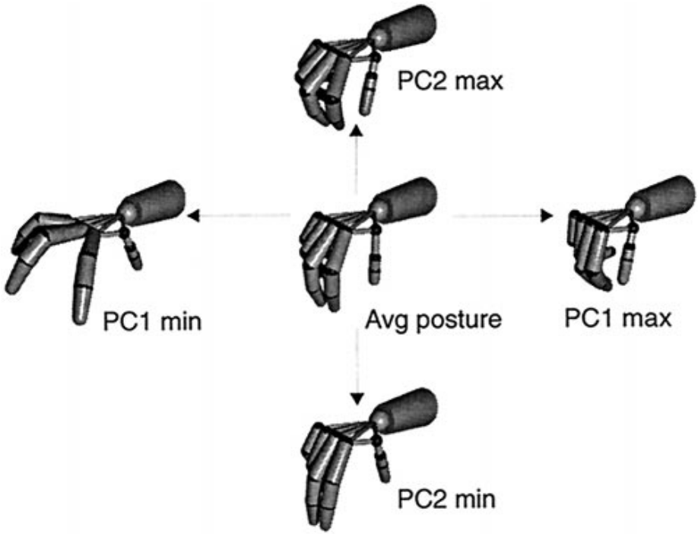
Synergies
Robotic hands have many DoFs; difficult to control manually.
Humans use Postural Synergies to simplify control.
Objective: Use human synergies to drive robots with different kinematics.

Slide 3
The Correspondence Problem
Human vs. Robot hands are rarely identical.
Joint Mapping: Fails on non-anthropomorphic robots.
Fingertip Mapping: Fails to respect internal joint limits/collisions.

Slide 4
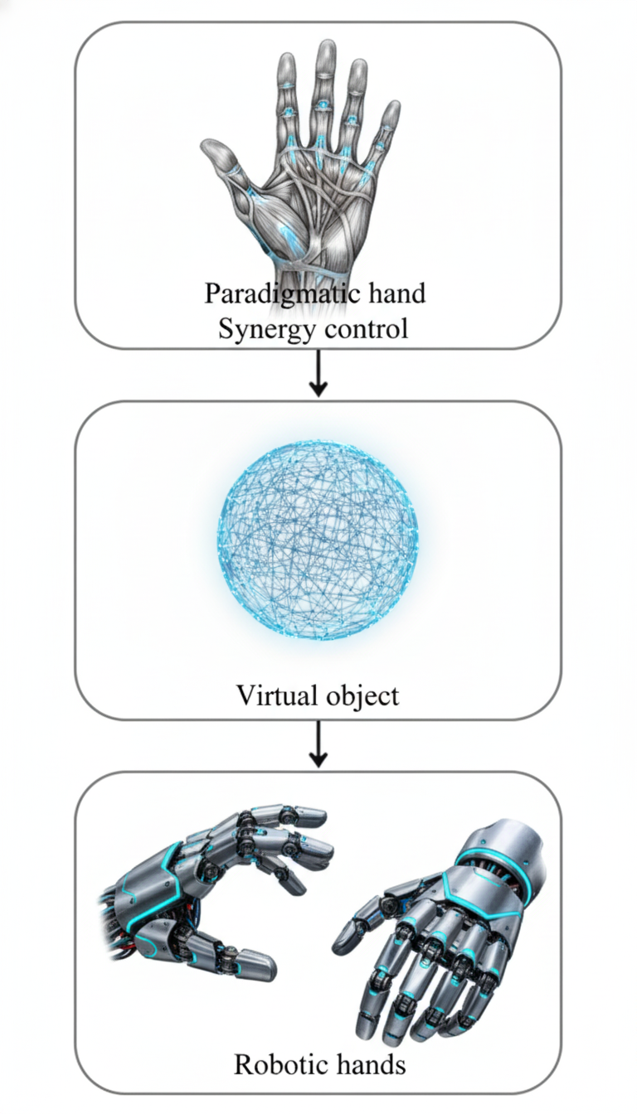
The solution: Virtual Sphere
Based on Gioioso et al. (2013).
Map the object, not the hand.
As the hand moves, the sphere deforms.
The robot acts to match this sphere deformation.

Slide 5
System Pipeline
Acquisition
The Weart TouchDIVER G1 haptic glove captures sensor data.
Reconstruction
Neural network used to reconstruct the full pose.
Transmission
Joint angles sent to the Unity simulation in real-time.
Retargeting
Actuation
Joint velocities integrated to update the visual pose.
Mapping from sphere to joint velocities of the target robotic hand.

Slide 6
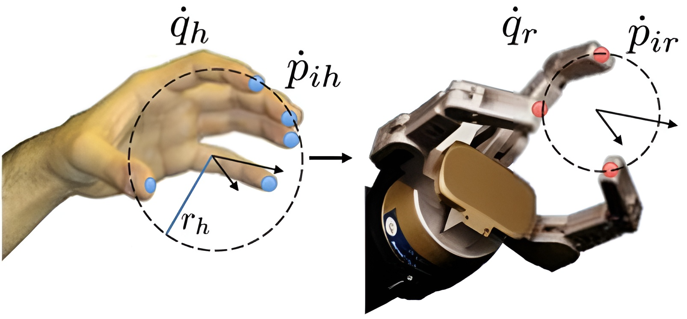

Mathematical Framework
Interaction Matrix ($A$): Relates fingertip velocity to sphere velocity.
Scaling ($k_{sc}$): Matches human hand size to robot hand size.
Solver: Damped Least Squares (DLS) for stability.

Slide 7
Redundancy Resolution
Null-Space Projection: Optimizes internal joints without affecting the grasp.
Goal: Keep joints centered (away from physical limits).

Slide 8
Robot Models
Barrett Hand
Mia Hand
Shadow Hand

Slide 9

Metrics
Potential Elastic Energy:
$$Eₕ=0.5 ∗ k ∗{\left(Δxₕ\right)}^{2}$$
$$E_{r}=0.5∗k ∗{\left(Δx_{r}\right)}^{2}$$
Reference energy for the robotic hand:
$$E_{ref}=E_{h}∗{\left(k_{sc}\right)}^{2}$$
Relative Energy Error (%):
$$\frac{\left|E_{r}−E_{ref}\right|}{E_{ref}}∗100$$

Slide 10
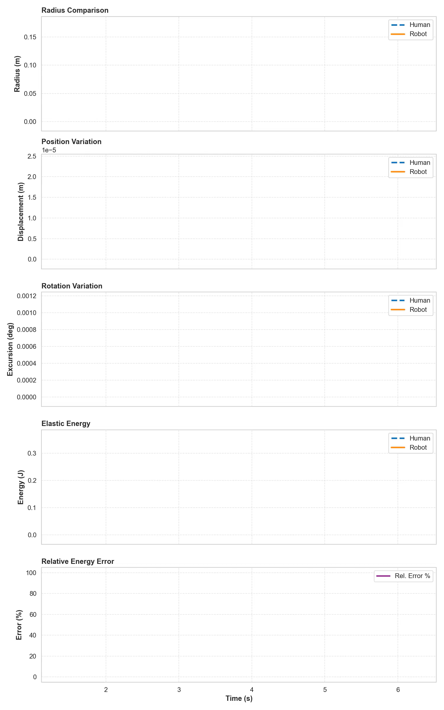
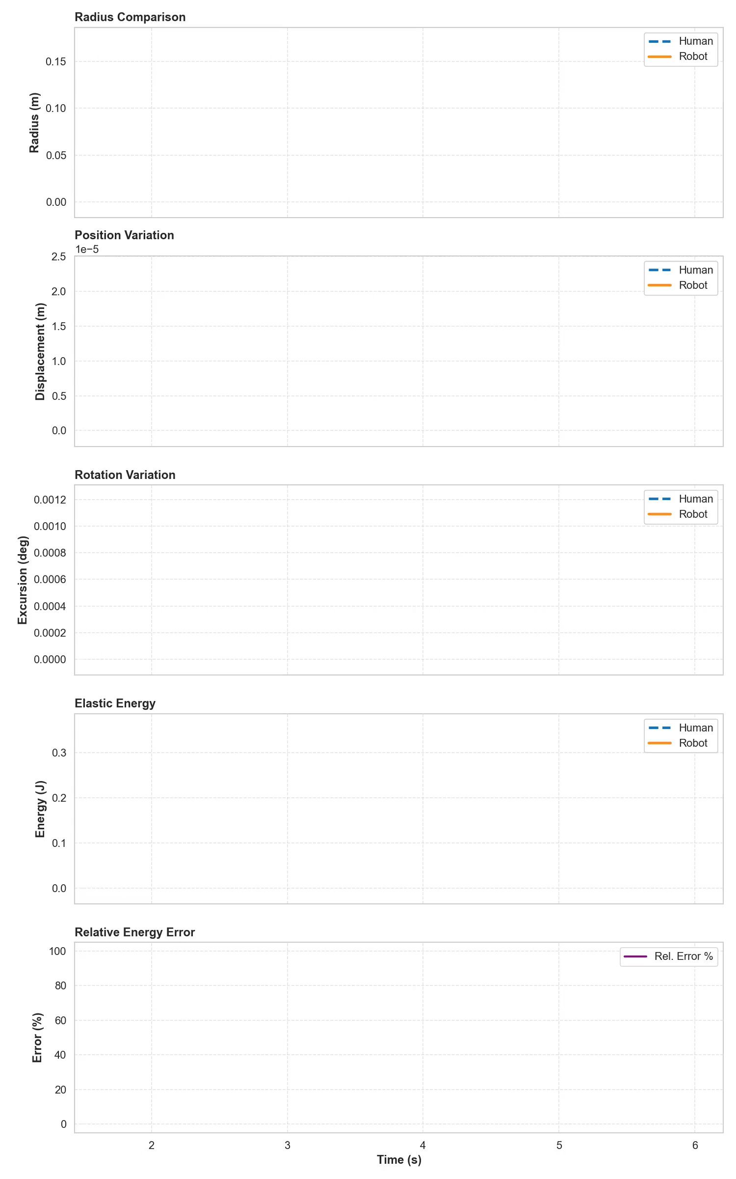
Barrett Hand
Using Null-Space
Without Null-Space

Slide 11
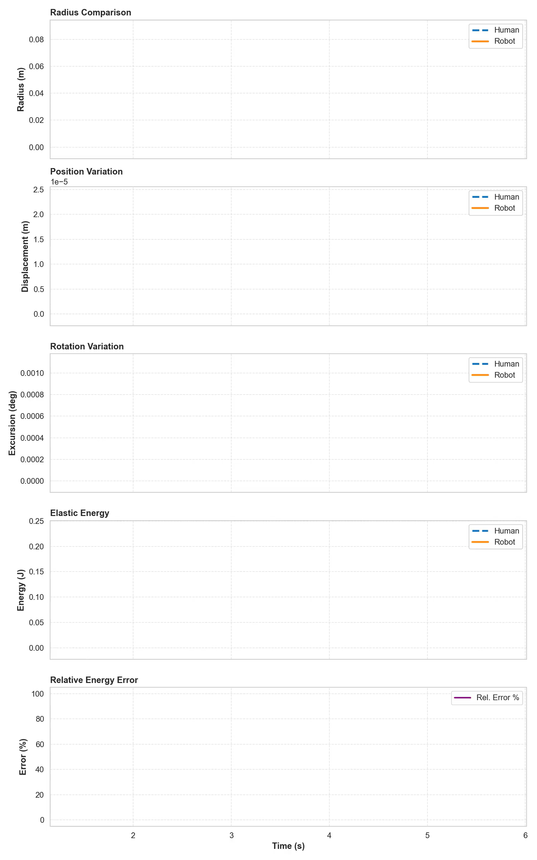
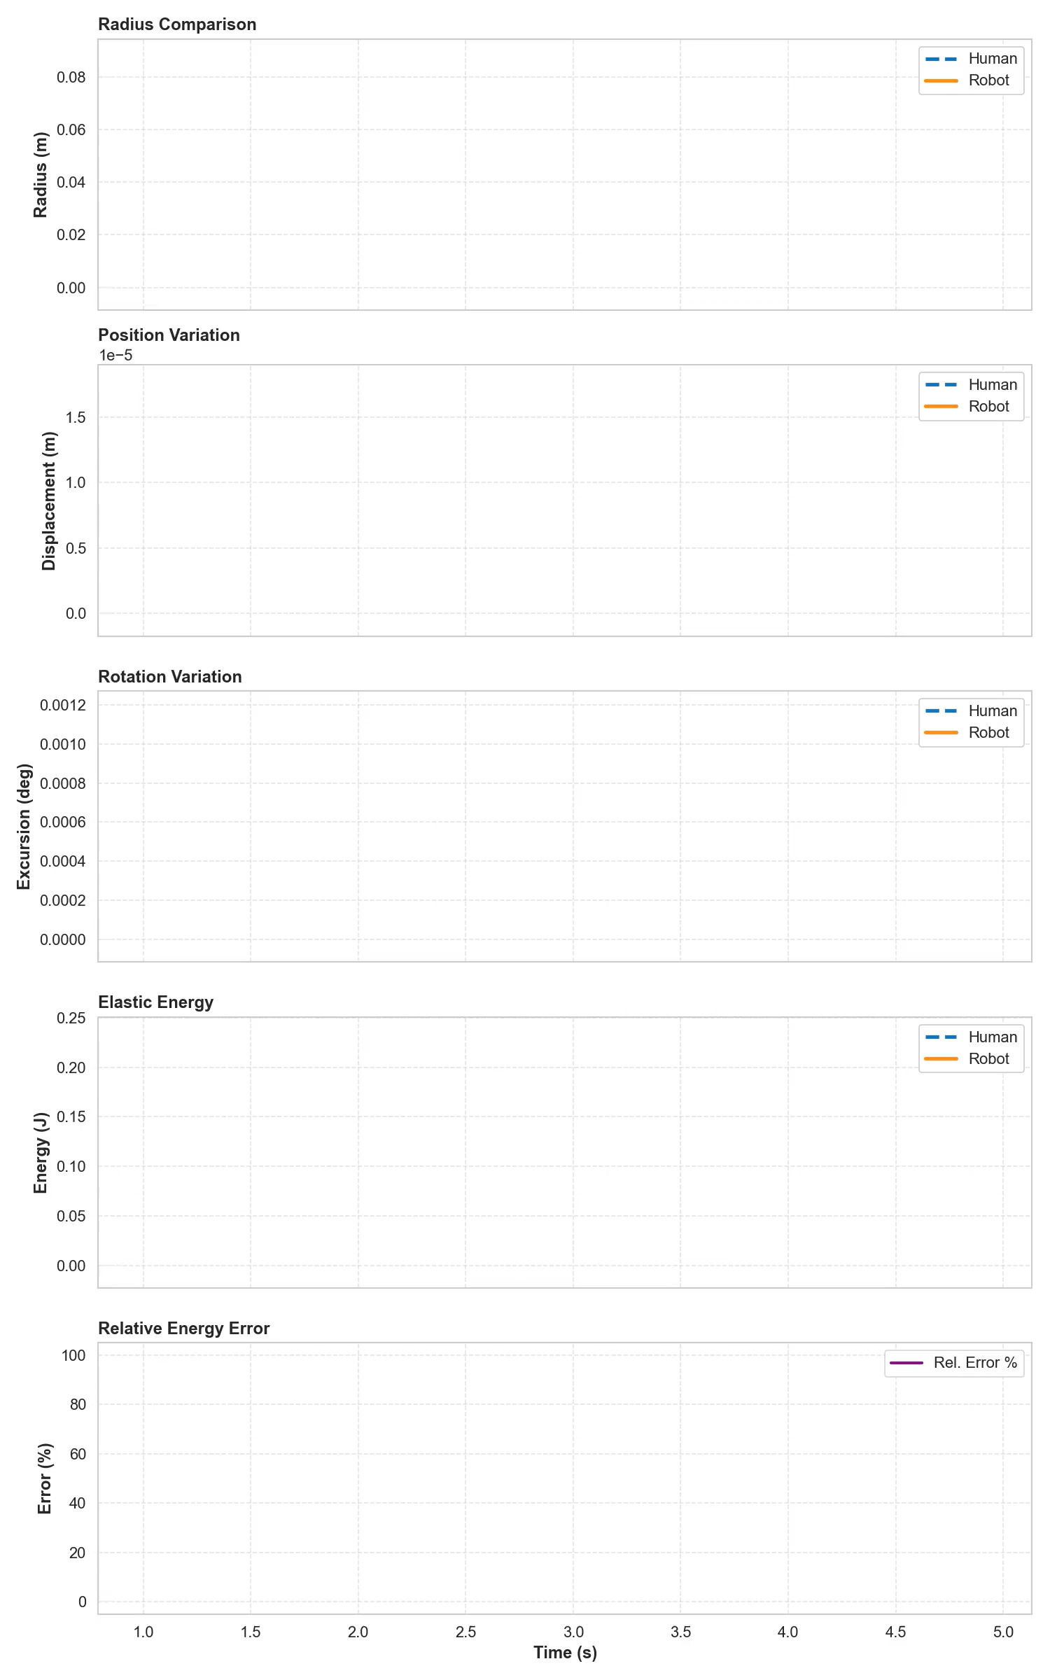
Mia Hand
Using Null-Space
Without Null-Space

Slide 12
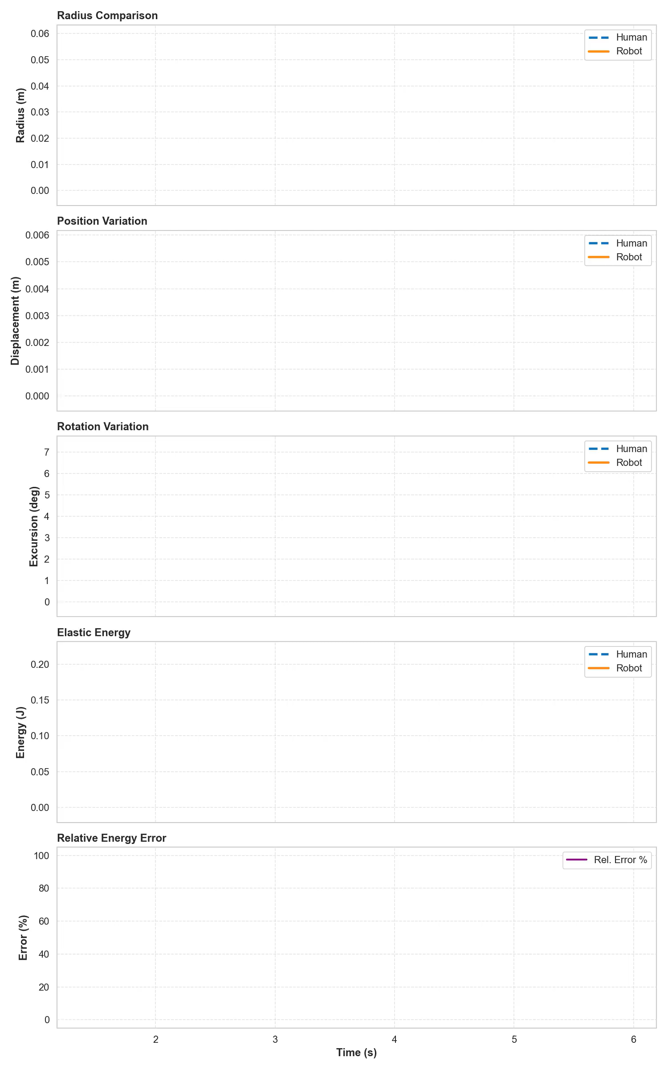
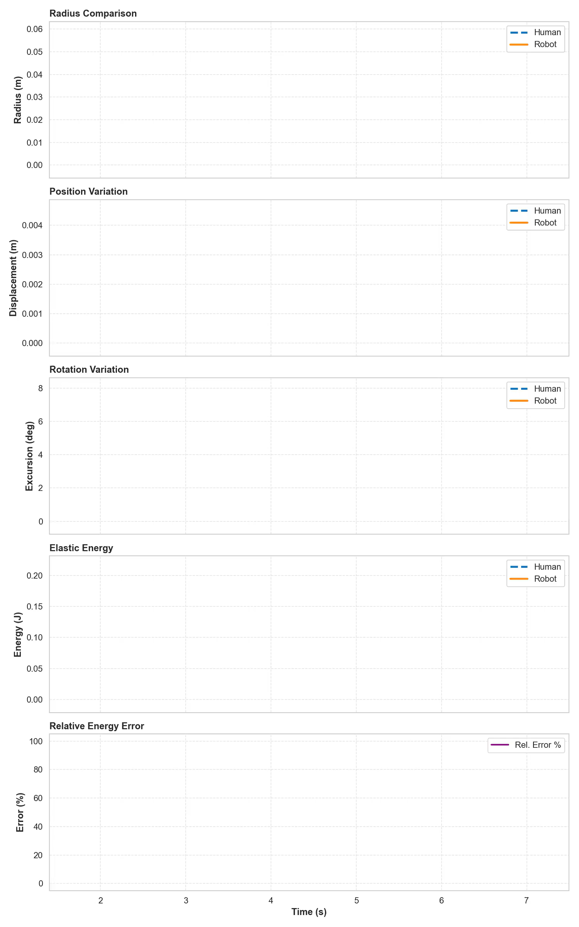
Shadow Hand
Using Null-Space
Without Null-Space

Slide 13
Conclusions

